Slide 1
Using Genomics in Hospital Outbreaks and Endemic Transmissions
Windy Tanner, PhD MSPH

Slide 2
Genomics and Healthcare Outbreaks
Whole genome sequencing is increasingly being utilized for investigations of outbreaks in a variety of healthcare settings.
Useful for understanding transmissions and spread of healthcare-associated infections (HAIs)
Investigations previously used various typing methods (spa typing, MLST, PFGE), which were often unable to sufficiently discriminate between bacterial isolates from common strains.

Slide 3
Genomics and HAI transmissions
What genomics has taught us about hospital transmissions
Intra-facility transmissions are less common than previously thought
More pathogen importations than previously thought
Limited clonal outbreaks
Example:
Clostridioides difficile previously believe to be primarily spread in hospitals.
WGS has shown that more Cdiff cases are imported than previously realized—turning attention to community transmission or possible acquisition during previous healthcare encounters

Slide 4
Important considerations for HAIs and genomics
Colonization vs. infection—can be difficult to determine when transmission occurred
Long term colonization and within-host diversity
Transmission vs. onset
Asymptomatic patients may be missing links
Linked patients may be missing epidemiological overlap
Environmental sources where organisms may proliferate
Transmission of mobile genetic elements

Slide 5
Example: Asymptomatic C. difficile patients
Patient A
(Sympt)
2 SNVs
Patient B
(Asympt)
2 SNVs
Patient C
(Sympt)
4 SNVs
Example: Continuous Environmental Reservoir
Patient A
Patient B
Patient C

Slide 6
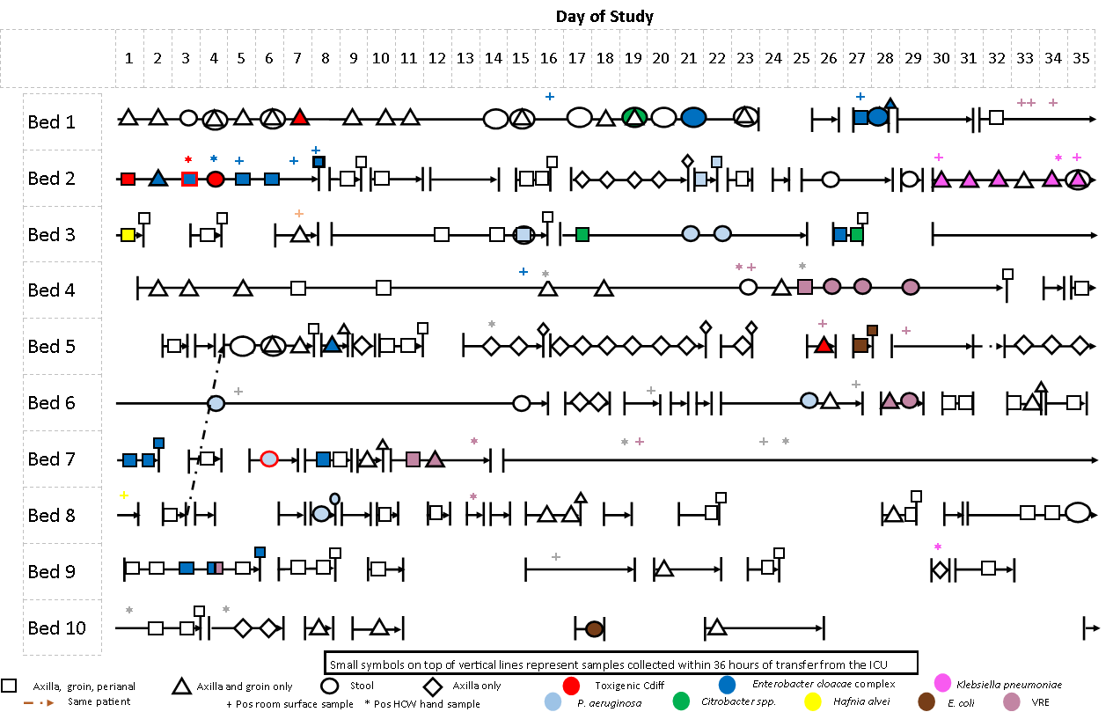
= on contact precautions
Facility B
Notes:
Vast majority of cases were not known infections or patents on contact precautions

Slide 7
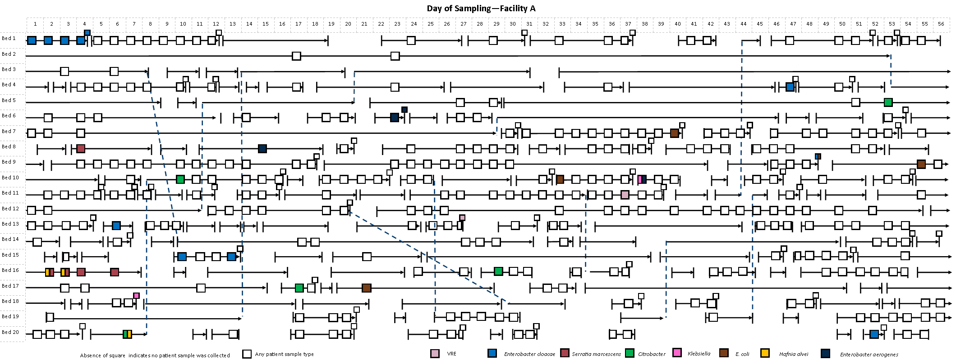
Notes:
Similarly—none of these patients were on contact precautions for known MDROs

Slide 8
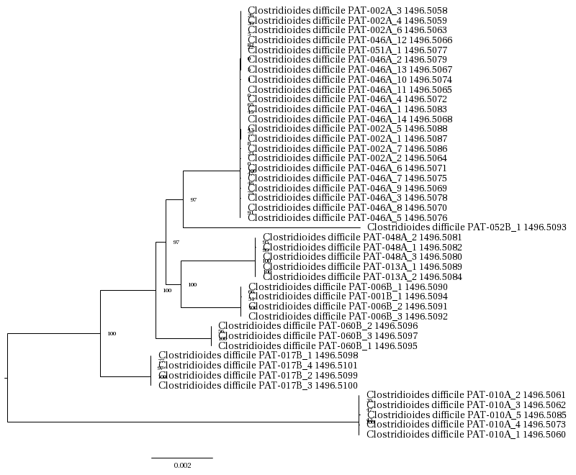
Example: C. difficile

Slide 9
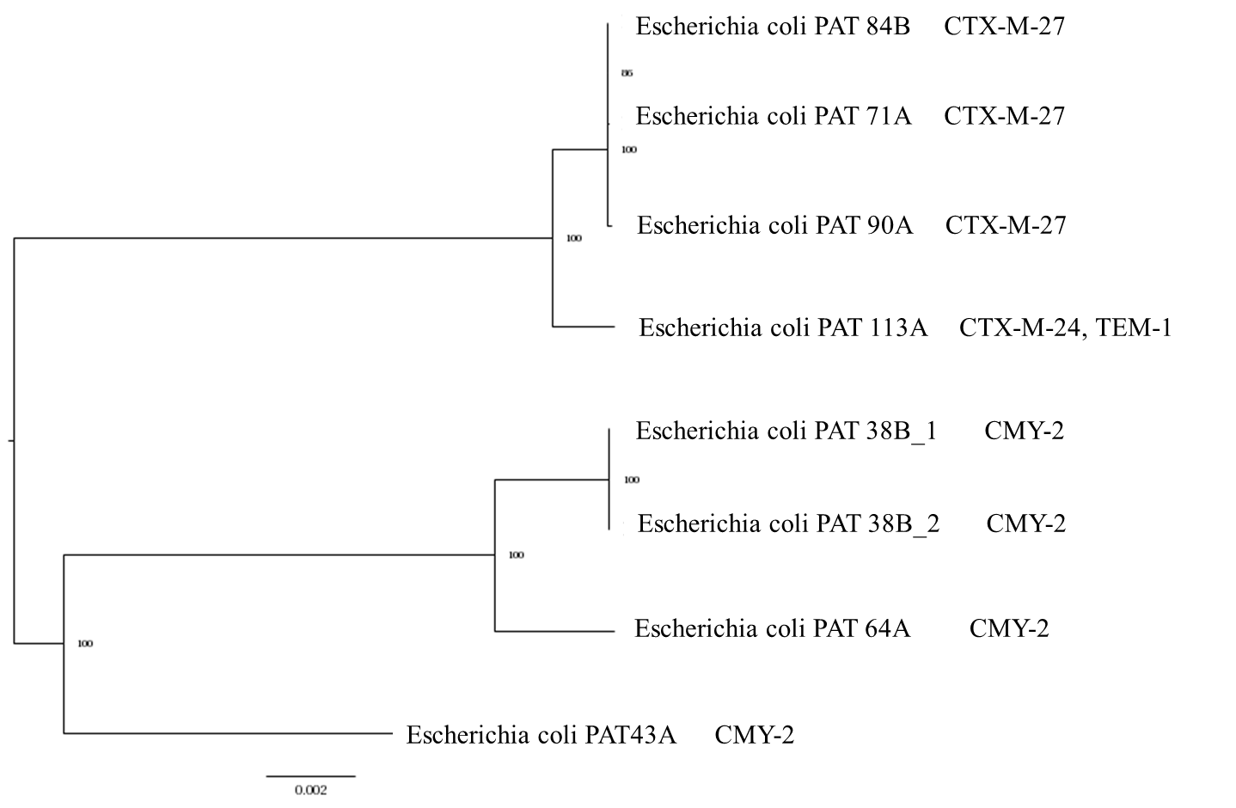
Example: E. coli with beta-lactam resistance genes
Notes:
Facility crossover?

Slide 10
Suggested approaches moving forward
Genomic surveillance in addition to epidemiological surveillance
Prospective integration of genomic and epidemiological data
Targeting multiple nosocomial pathogens and sequencing isolates from patients and potential sources
Sequencing of isolates from multiple facilities to adequately address regional spread

Slide 11
Investigating Epidemic Spread
EMD 531
Lecture 15
Mary Petrone

Slide 12
Overview
Introduction to phylogeography
Basics of generalized linear modelling and its application in phylogeography
Public health applications of phylogeography (vaccine selection)

Slide 13
Phylogeography

Slide 14
Phylo-???
Phylogenetics
Inferring epidemic processes using genomic data
Inferring evolutionary relationships using genomic data
Phylodynamics
“Phylodynamics relies on phylogenetic inference as the core analytical tool to recover evolutionary and epidemic processes from the mutations that accumulate in the genomes of rapidly evolving pathogens during spread of an epidemic” (Baele et al, 2017)
Phylogeography
Inferring spatial relationships using genomic data

Slide 15
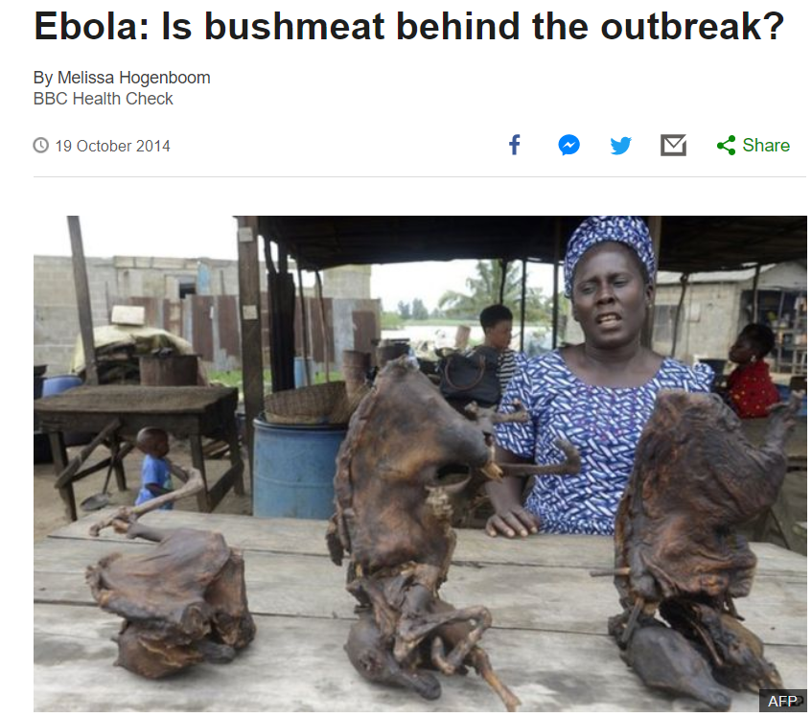
The role of phylodynamics in outbreak investigation
Important questions when investigating an outbreak:
When was the pathogen introduced into the population?
Where did the pathogen come from?
Zoonosis?
A neighboring region?
A different country?
How is the pathogen spreading? (GLM)
Movement of the pathogen via long distance (air) travel?
Autochthonous re-introductions?
Are certain climatic factors necessary?
Where might the pathogen spread?
Enables targeted implementation of control measures

Slide 16
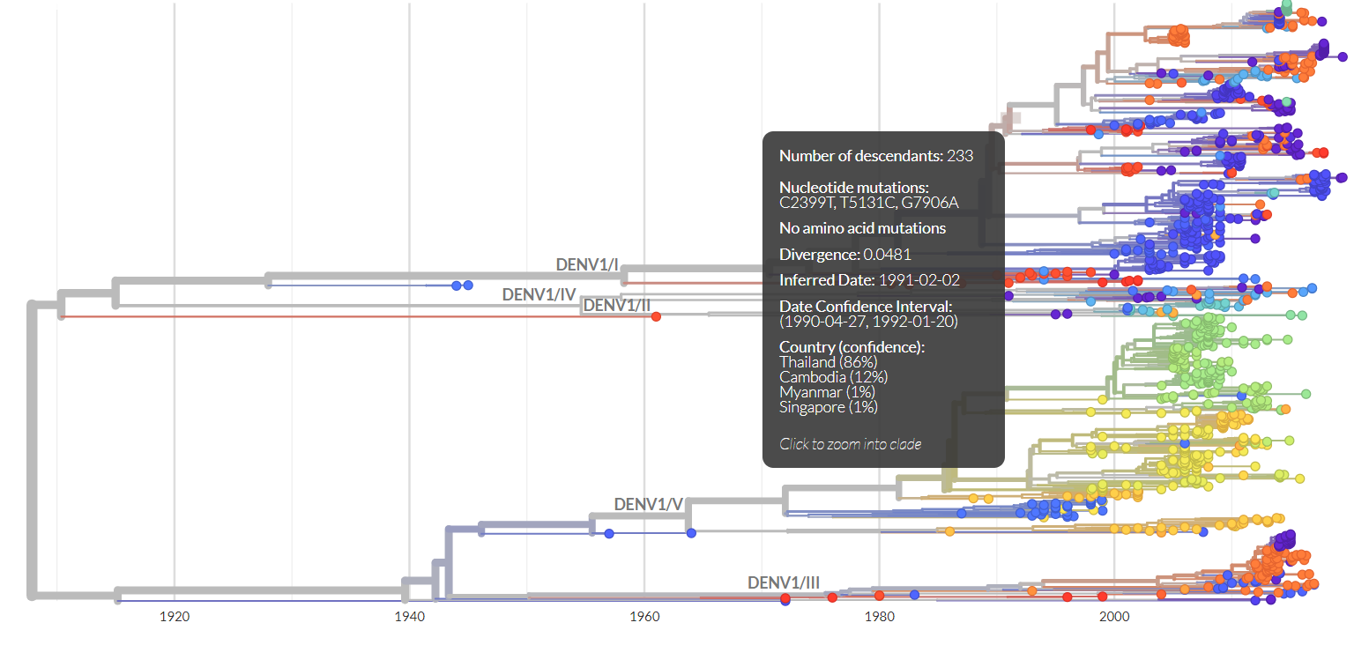
Nextstrain uses phylogeography
Nextstrain.org

Slide 17

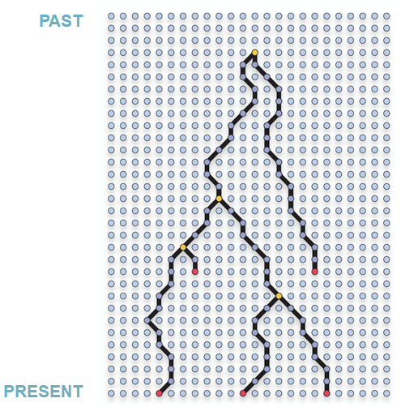
What’s in a node?
Flash back to Lecture 7

Slide 18
We can draw spatial inferences about nodes, but what about branches?
It depends!
Continuous vs. discrete phylogeography

Slide 19
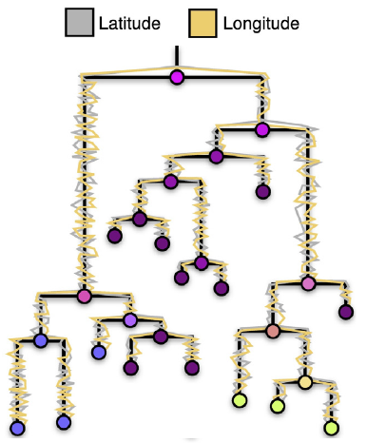

Modelling movement
Continuous diffusion: movement is inferred along branches
Vectorstock.com
Adapted from Baele et al. (2018)
What if we were investigating an outbreak throughout the Caribbean?
Notes:
Red dots = sampled sequences
White dots = potential inferred transmission events

Slide 20
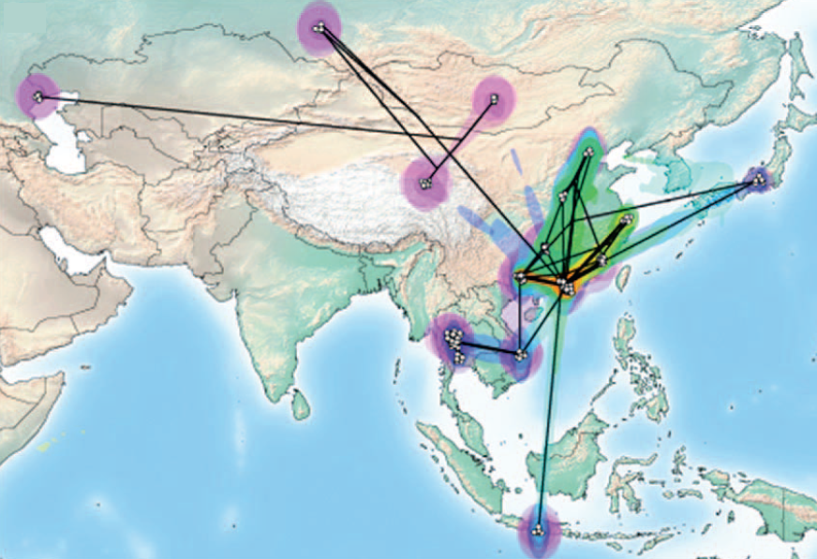
Modelling movement
Example: mapping the spread of avian H5N1 in Guangdong province
Adapted from Faria et al. (2011)
Notes:
Continuous phylogeography- taking a phylogeographically resolved tree and transposing it on a map

Slide 21
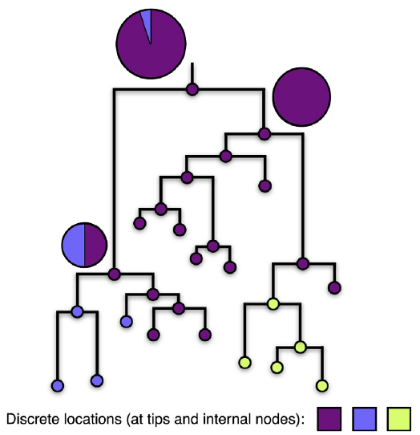
Modelling movement
Discrete phylogeography: location is modelled as a trait at each node
Adapted from Baele et al. (2018)
Nextstrain.org

Slide 22
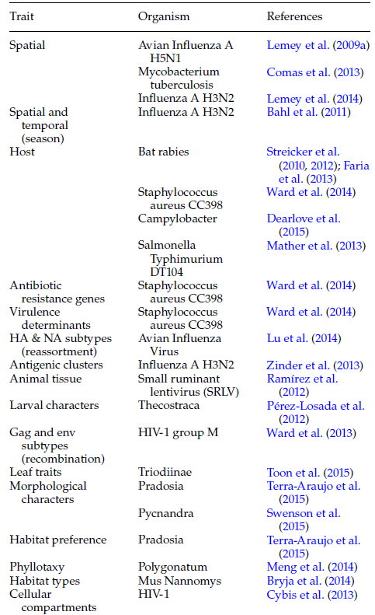
(Side note) You can model a variety of characteristics as discrete traits
Adapted from Baele et al. (2016)

Slide 23
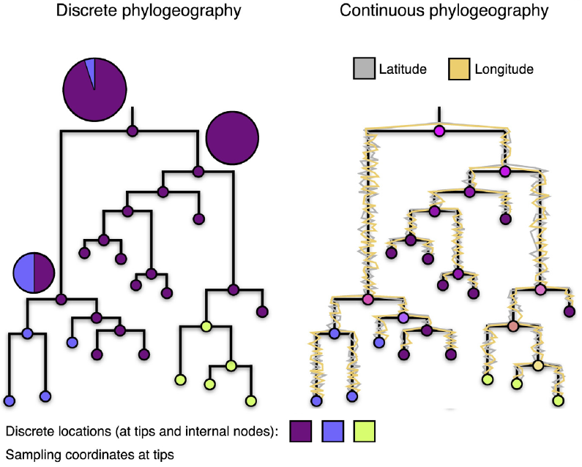
Advantage:
Does not lead to geographically implausible inferences
Advantages:
Less sensitive to sampling biases compared to discrete models
Can provide a more granular picture of epidemic spread
Disadvantages:
Highly sensitive to sampling biases in your data
Cannot infer transmission events at unsampled locations
Disadvantages:
Can only be used when studying contiguous land masses
Requires higher geographic resolution at tips
Adapted from Baele et al. (2018)

Slide 24
Generalized Linear Modeling

Slide 25
GLM Basics
Effect size of covariate (estimated by the model)
$$log (Λ_{ij}) = δ_{1}β_{1}X_{ij1} + δ_{2}β_{2}X_{ij2} + ... + δ_{n}β_{n}X_{ijn}$$
Covariate value
Binary indicator (do we include this covariate in our model?
Transition rate matrix
x
x

Slide 26
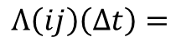
Transition rate matrix
$$log (Λ_{ij}) = δ_{1}β_{1}X_{ij1} + δ_{2}β_{2}X_{ij2} + ... + δ_{n}β_{n}X_{ijn}$$
Imagine you are investigating a West Nile virus (WNV) outbreak in the US
You collect and sequence 100 WNV samples and construct a phylogeographically-resolved tree
From your tree, you ascertain the following data:
Origin (i) | Destination (j) | # Instances
New York | Massachusetts | 10
New York | California | 32
Connecticut | New York | 13
Michigan | North Dakota | 3
California | New York | 21
California | Texas | 15
Nevada | California | 6
Total |  | 100
Origin (i)
10 | 13 | 0 | 21 | 0
32 | 0 | 0 | 0 | 6
0 | 0 | 3 | 0 | 0
0 | 0 | 0 | 15 | 0
0 | 0 | 0 | 0 | 0
Destination (j)
$$Λ\left(ij\right)\left(∆t\right)=$$

Slide 27
Model covariates
$$log (Λ_{ij}) = δ_{1}β_{1}X_{ij1} + δ_{2}β_{2}X_{ij2} + ... + δ_{n}β_{n}X_{ijn}$$
Travel data (flights, cruises, traffic)
Proxies for socioeconomic status (e.g. average life expectancy, unemployment rate)
Climate data (e.g. temperature, humidity, land-use)
Population density
Distance between populations
Time since last outbreak
…Any measurable characteristic that you can obtain for every population in your model

Slide 28
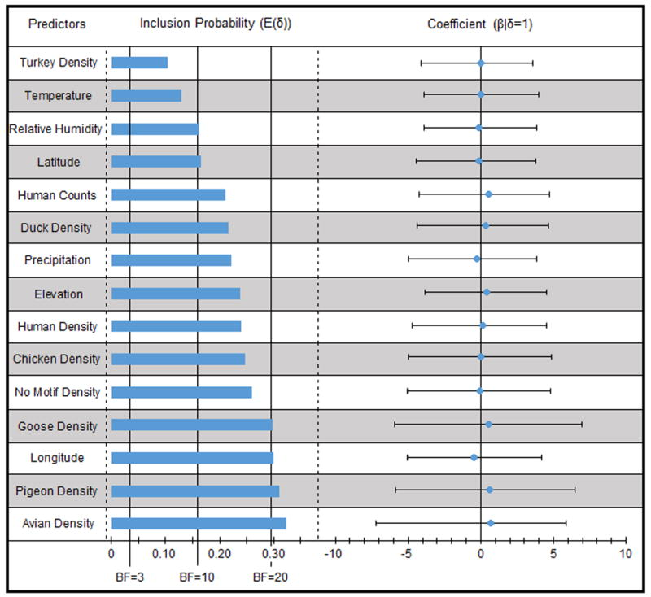
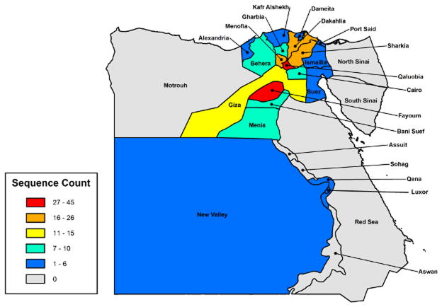
Example: Predictors of human and avian H5N1 spread in Egypt
Magee et al., (2015) Arch Virol.

Slide 29
Applications of phylogeography

Slide 30
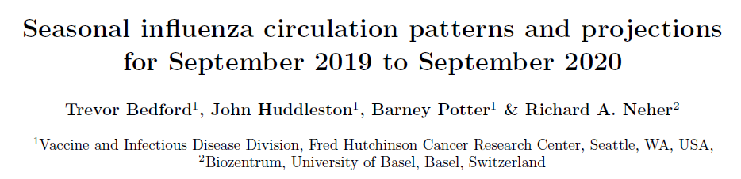
Influenza vaccine selection
Predicting antigenic properties of future influenza outbreaks
Influenza on Nextstrain

Slide 31
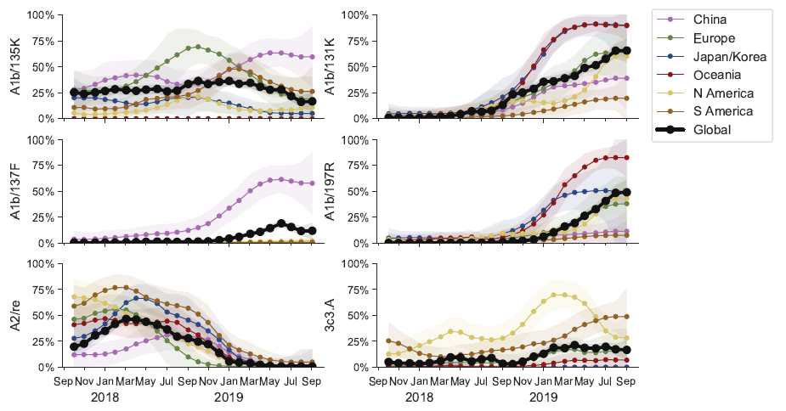
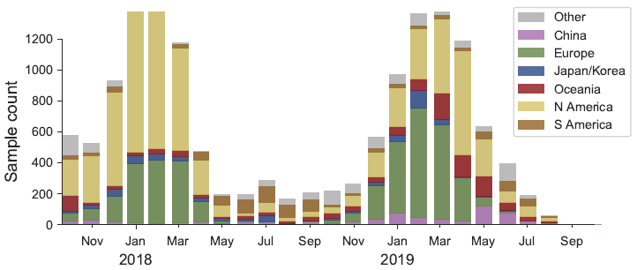
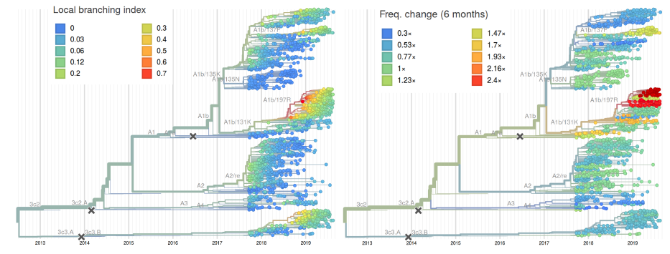
H3N2 phylogenies
Clade frequencies
Case counts

Slide 32
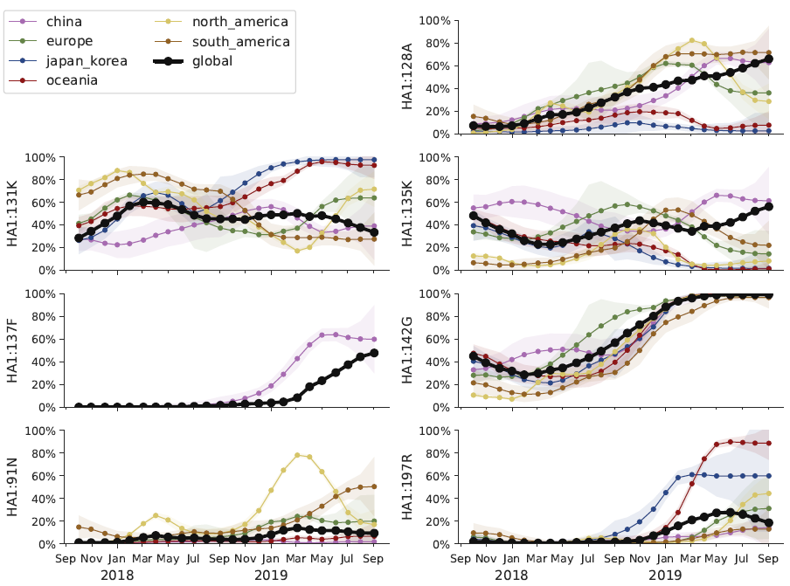
Integrating geographic data

Slide 33
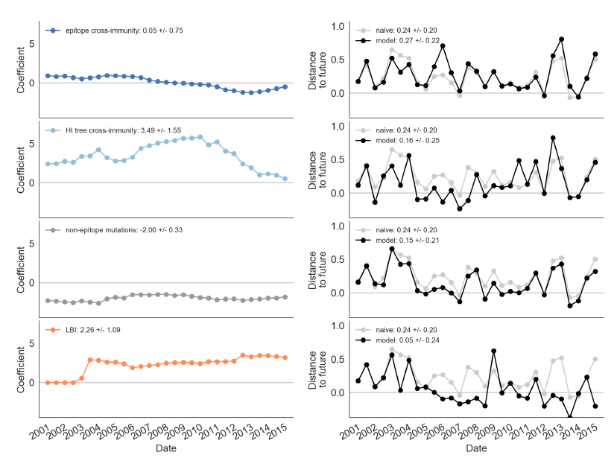
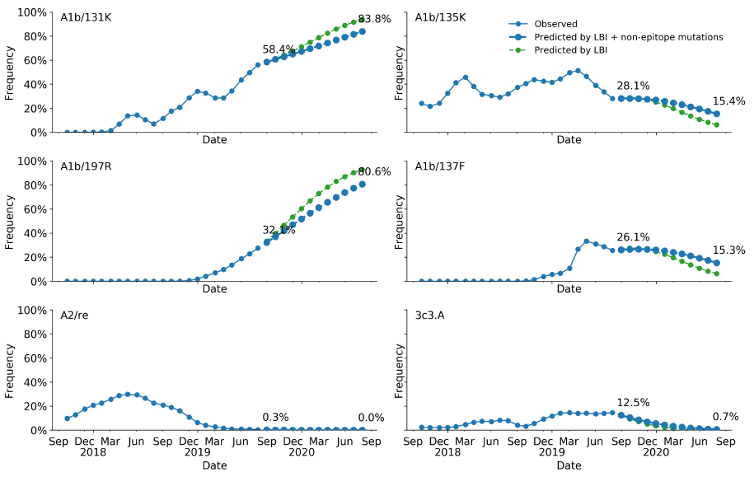
Translating evolution into fitness to make predictions
Modelling fitness
Frequency projections based on fitness

Slide 34
Take home message #1: Phylogeography is becoming an increasing important tool in disease control and policy decisions relating to outbreaks

Slide 35

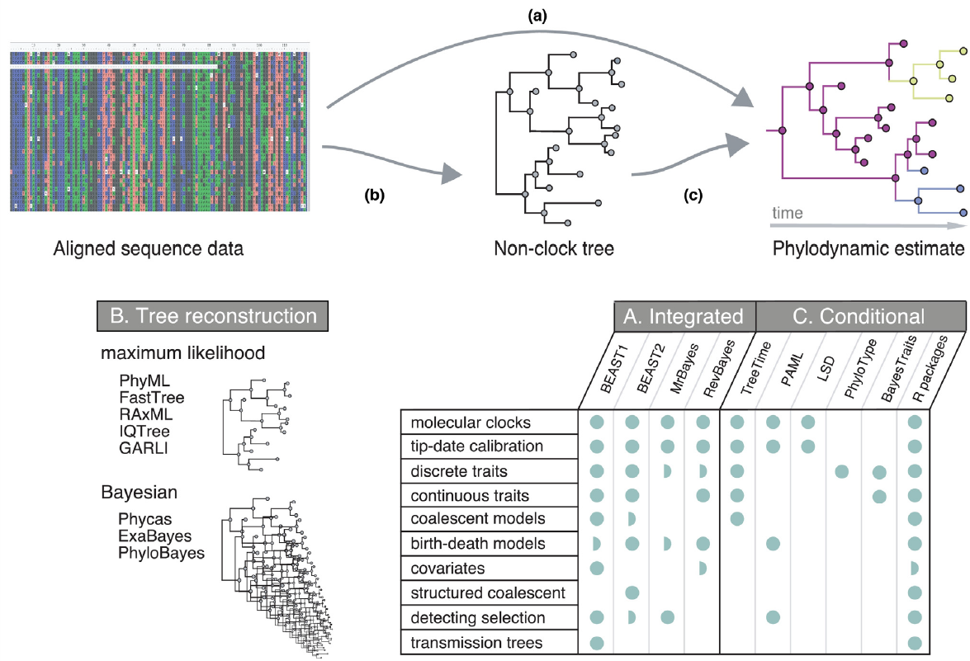
Take home message #2: You too can do this!
http://beast.community/

